Slide 1
Entrepreneurial Finance
NanoGene Case
Fall 2025
Professor Burnes
Leeds School of Business
University of Colorado Boulder
Jack Terranova Supplemental Slides
November 17, 2025
Leeds
B U S I N E S S
Page 1

Slide 2
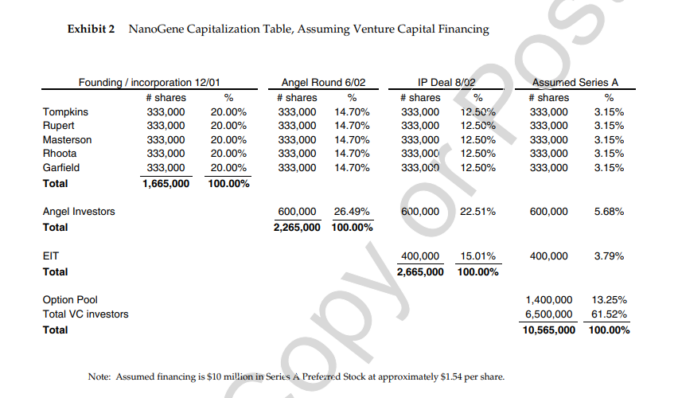
NanoGene Cap Table
Does the equal equity split among the five founders still make sense once you consider what the company needs to succeed going forward?

Slide 3
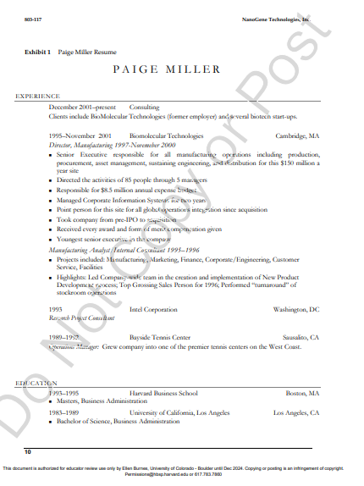

To Hire or not to Hire?
Based on Paige’s resume, is she worth the compensation she’s asking for — and how should NanoGene decide that?

Slide 4
Brief Review of SPACs and IPOs

Slide 5
What is a SPAC?
SPAC = Special Purpose Acquisition Vehicle
A publicly traded shell company formed to acquire or merge with a private business.
Raises cash through an IPO with no operating business at the time of listing (aka: Blank Check Company”
Provides a faster, alternative path for private companies to become publicly listed via a merger rather than a traditional IPO.

Slide 6
SPAC High Level Mechanics
Going Public
Management Team
of Industry Experts Formed
Bankers, Lawyers and Auditors Hired
SPAC Raises $500M in an IPO
(Nasdaq: [SPAC])
Once Public
Team has 18-24 months to acquire a private company
Shareholders Vote & Redemptions
Shareholders vote to approve/deny merger and may elect to recover their funds from the escrow
Management team meets 100s of companies and finds an attractive private merger target
$500M in IPO Investor funds sit in escrow and earn interest
SPAC merges with private company -- private company get access to cash and is now publicly traded

Slide 7



SPAC vs. IPO
SPAC
IPO
SPAC
IPO
Investors
SPAC
Investors
Operating Co
Some Cash goes
back to investors
SPAC
Operating Co
Merges with
Timing: 18-24 mo. for SPAC // <6 mo. for OpCo
Timing: Anywhere from 9-24 months
Cost: ~3-4% of proceeds for SPAC // <$1M for OpCo
Cost: Anywhere from $1.5M - $10M+
Result: OpCp becomes public company – Between 0% and 100% of escrow funds go to OpCo (net of transaction fees)
Result: OpCo becomes public company –100% of funds go to OpCo (net of transaction fees)

Slide 8
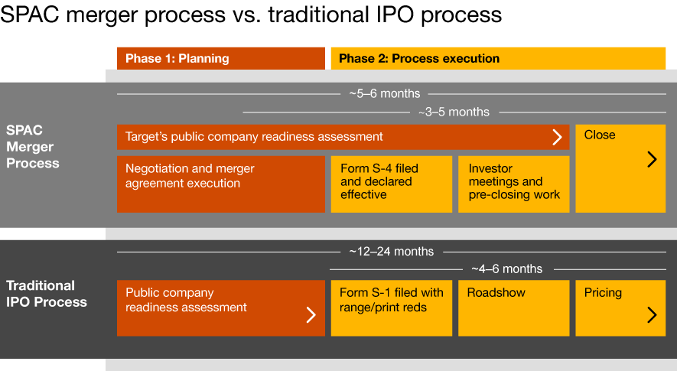
SPAC vs. IPO Timeline
Source: https://tehcpa.net/what-is-a-spac-and-why-are-some-private-tech-companies-choosing-it-as-a-way-to-go-public-on-wall-street/

Slide 9

SPAC vs. IPO (From Private Company Perspective)
SPAC
IPO
SPAC
IPO
Time to Market
Cost
Deal Structure
Minimizing Dilution
Stock Performance
Regulatory Scrutiny
Access to Market

Slide 10
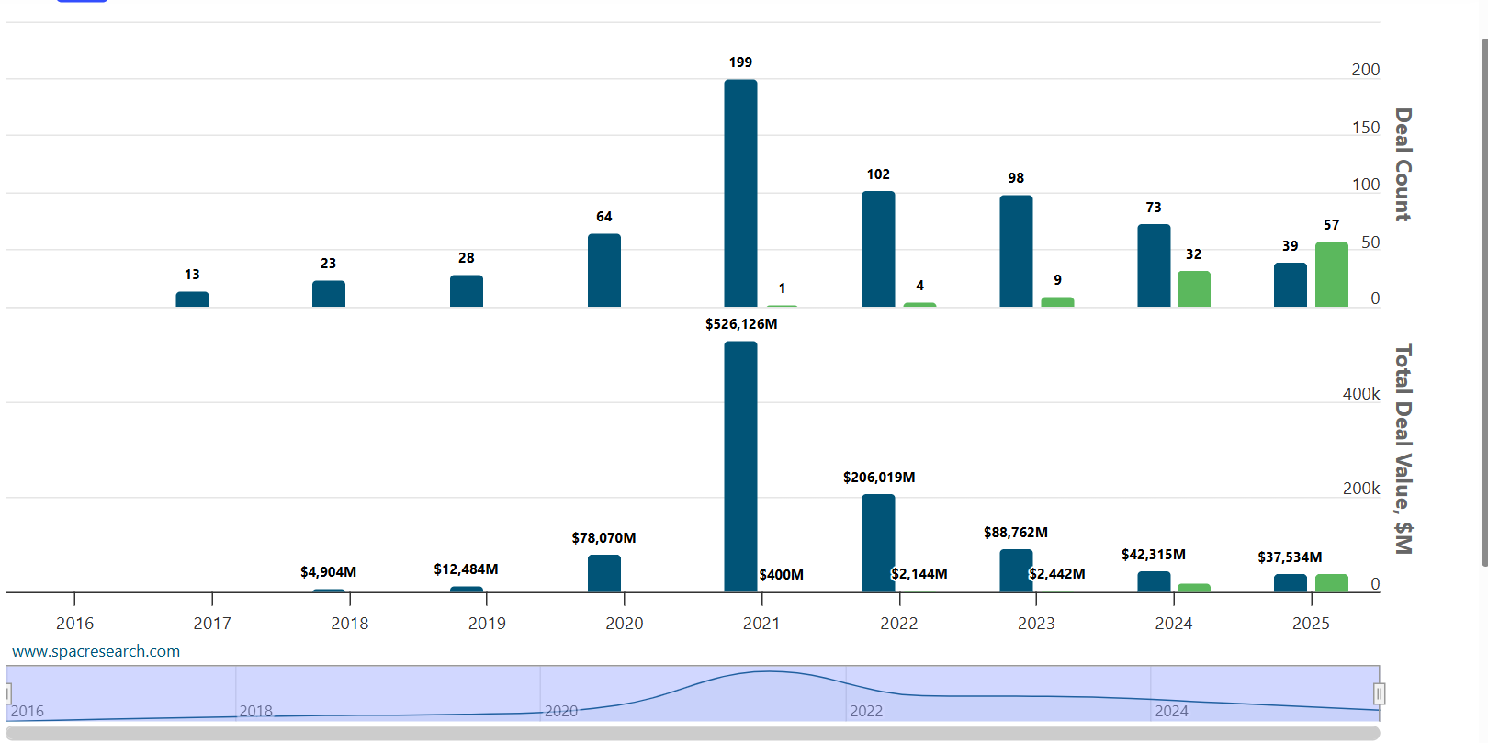
SPAC Activity (Last 10 years)
Closed SPACs
Pending SPACs (“Searching”)

Slide 11
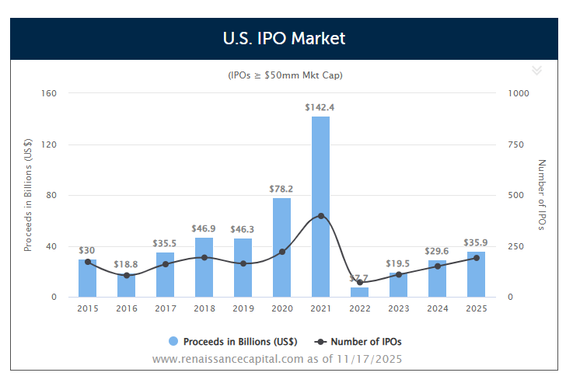
IPO Activity (Last 10 years)

Slide 12
The Devil is in the (SPAC Structure) Details
Don’t worry – you won’t be tested on this!!!

